Slide 1
Client stats Data Analysis
By Gowthami Manchuri

Slide 2
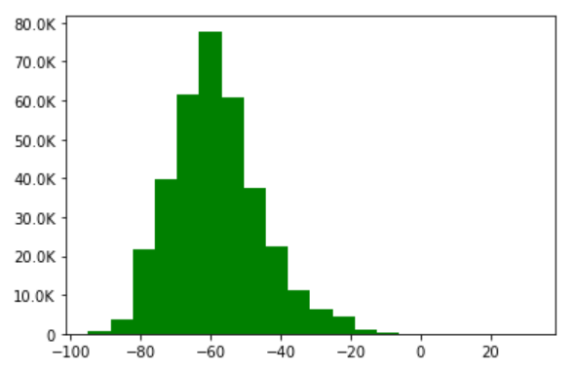
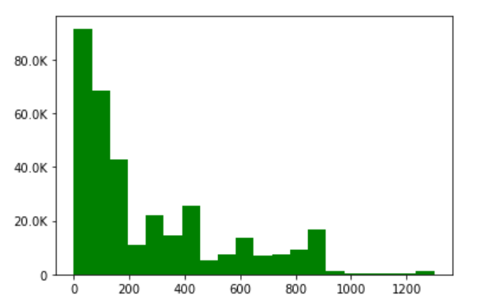
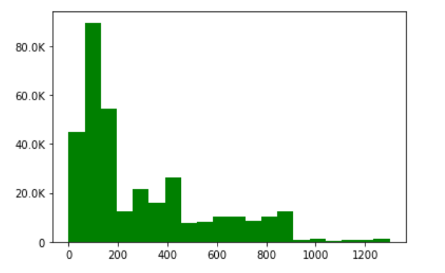
Spread of RSSI levels
Spread of Rx Weighted PhyRate
Spread of Tx Weighted PhyRate

Slide 3
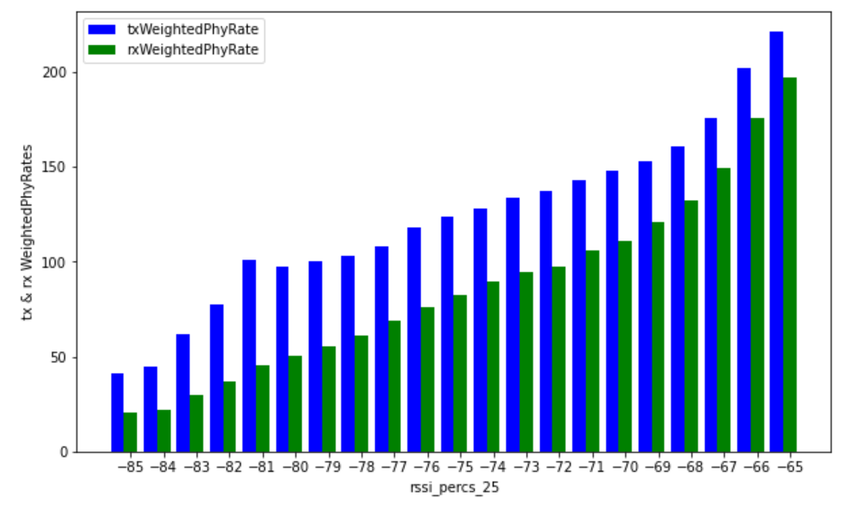
histogram for the average Tx and Rx Weighed Phy Rate between -85 and -65 dB
Observations: In a given range of RSSI levels both Tx & Rx Phyrates are directly propotional to each other
as RSSI values are increasing. The avg Tx weighted Phyrate is more at the point of -81DB of RSSI than -80DB.

Slide 4
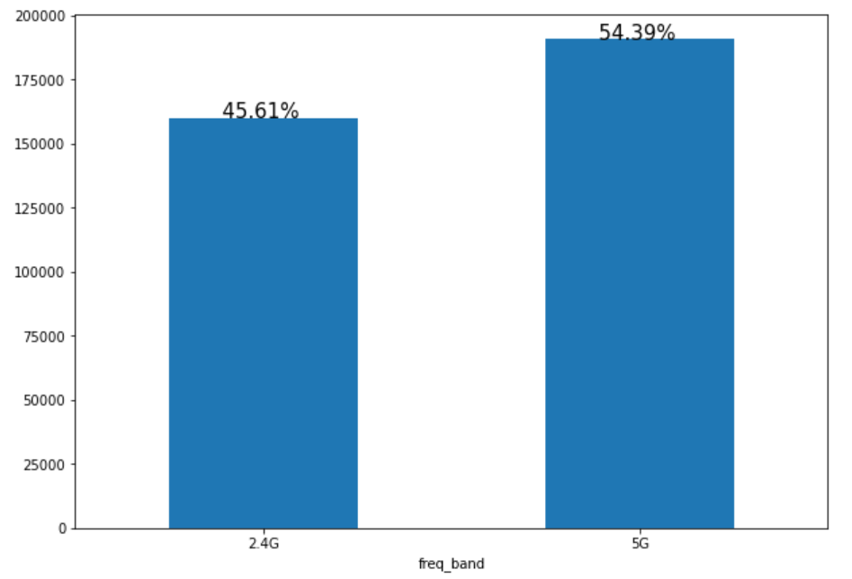
% of devices are connected to 2.4 GHz and 5 GHz
Observations: 54.4% devices (i.e.,190k among 350k) are connected to 5G
45.6% devices (i.e.,160k among 350k) are connected to 2G

Slide 5
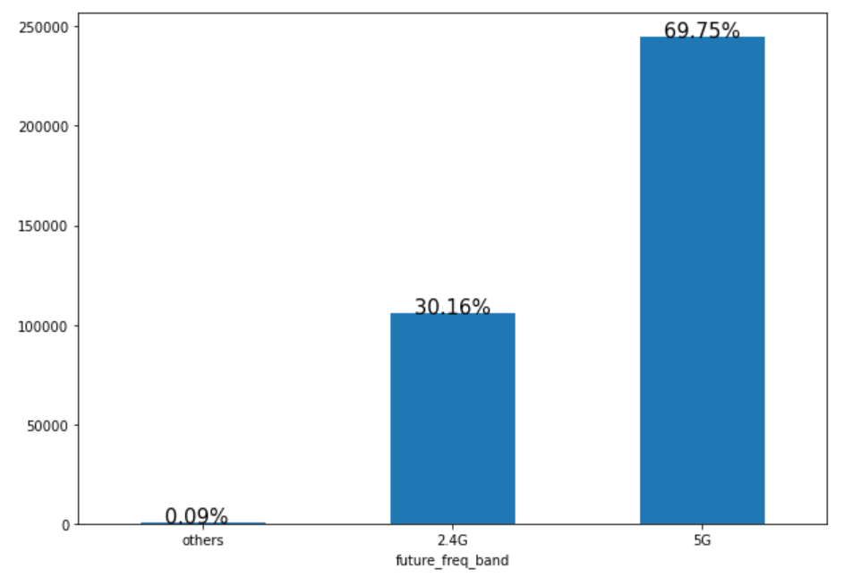
% of devices that will be on 2.4GHz and 5GHz as per the Given conditions – Future Frequency Band
Observations: It is clearly stating that more number of devices(around 70%) will be connected to 5G in future

Slide 6
Thank You !!

